Slide 1
Development of a new Python-based cardiac phantom for myocardial SPECT imaging
John Wesley Mathis
ECE/SSE 591

Slide 2
What is SPECT?
Single Photon Emission Computed Topography
Nuclear Imaging
Shows blood flow to tissues and organs
Myocardial Perfusion SPECT
Evaluates blood flow to the heart muscle
Notes:
SPECT is a type of nuclear imaging test that shows how blood flows to tissues and organs
Myocardial Perfusion SPECT specifically used to evaluate blood flow to the heart muscle
Helps in diagnosing various heart conditions, such as coronary artery disease, and assessing heart muscle damage after a heart attack
Simulated Gated myocardial Perfusion SPECT simulates the heart’s pumping action (gating) to provide detailed images of the heart’s blood flow during different phases of the heart beat

Slide 3
Anthropomorphic Human Phantoms
Objects that simulate human tissues and organs to test and calibrate imaging devices
Used in nuclear medicine
Image acquisition
Reconstruction
Data analysis
Calibration, etc
Notes:
What is a phantom?
These are used in nuclear medicine to capture high quality images, to convert raw data into interpretable images, analyze the image data and even calibrate the instruments, ensure safety standards in radiological practices and more.

Slide 4
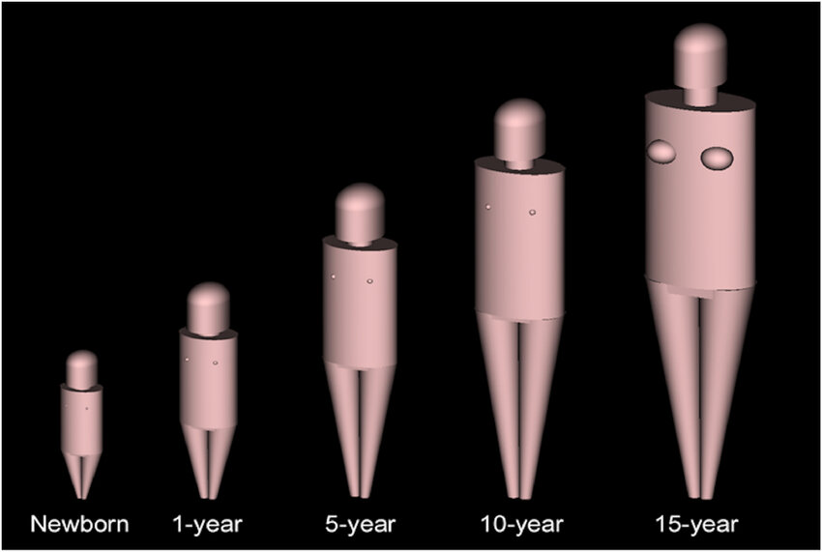
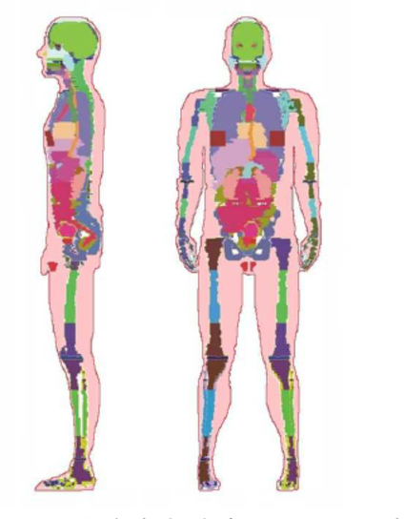
Types of Phantoms
Numerical Phantoms
Stylized Phantoms: Use mathematical equations to represent human anatomy
Analytical geometries
Voxel Phantoms: Use 3D imaging techniques like MRI or CT scans
More realistic, derived from human patients
Non-numerical phantoms
Physical models
Notes:
There are twoo types of phantoms: numerical and non numerical.
Numerical phantoms are either stylized phantoms such as what is shown in the top image. Styilezed phantoms use mathematical equations to represent human anatomy. Numericla phantoms can be voxel phantoms which use 3D imaging techniques to construct a more realistic model.

Slide 5
Quantitative Measurements
End Diastolic Volume(EDV)
Volume of blood in the left ventricle at the end of filling
End-Systolic Volume (ESV)
Volume of blood in the left ventricle after contraction
Ejection Fraction(EF)
Percentage of blood pumped out of the left ventricle during each heartbeat
Phase Analysis, Wall Thickening Motion, Perfusion Parameters
Various measures of heart function and blood flow
Defect Extent and Severity, Stress and Rest Scores, Total Perfusion Deficit(TPD)
Assessment of areas with poor blood flow and overall heart health
Notes:
There are numerous software programs that are used to derive quantitative information from gated myocardial perfusion SPECT. Some of these measurements include:

Slide 6
The Problem
Current Cardiac Phantoms limited in realism and flexibility
Stylized Phantoms lack detail of anatomical model
Voxel Phantoms are rigid and less flexible

Slide 7
Study Aim
Design a computational cardiac phantom
Simulate interfering Parameters
Accurate phantom for validating and improving the quantitative analysis software
Computational Phantom
Versatile and easily modifiable
Enhances imaging accuracy and diagnosis
Notes:
The aim of the study was to design a solution that could simulate various conditions and parameters such as wall thickness, volume, and count variation.
Additionally they wanted to design a phantom that was accurate because an accurate phantom is essential for validating and improving the quantitative analysis software used in SPECT imaging.
They chose to design a computational phantom because the modesl can easily be modified to simulate different cardiac conditions and abnormalites and they have an enhanced accuracy since they can provide more realistic and detailed simulations.

Slide 8

Why use Python?
High-Level programming language
Easy Syntaxes
Flexibility
More advantages over other languages
Notes:
They chose to use python because its easier to write and understand compared to other low-level languages. Its easy syntax simplifies programming tasks. Its flexible making it suitable for various appplications and in comparison to other languages it offers more in terms of ease of use and functionality.

Slide 9


Python Libraries Used
NumPy: numerical operations and matrix handling
SciPy: scientific computing, including optimization and interpolation
Notes:
The researchers primarily used Numpy for handling numerical operations with linear algebra and multi-dimensional arrays. And they also use scipy for its modules that contain image and signal processing, ordinary differential equation solvers, and many other functions.

Slide 10
Results

Slide 11
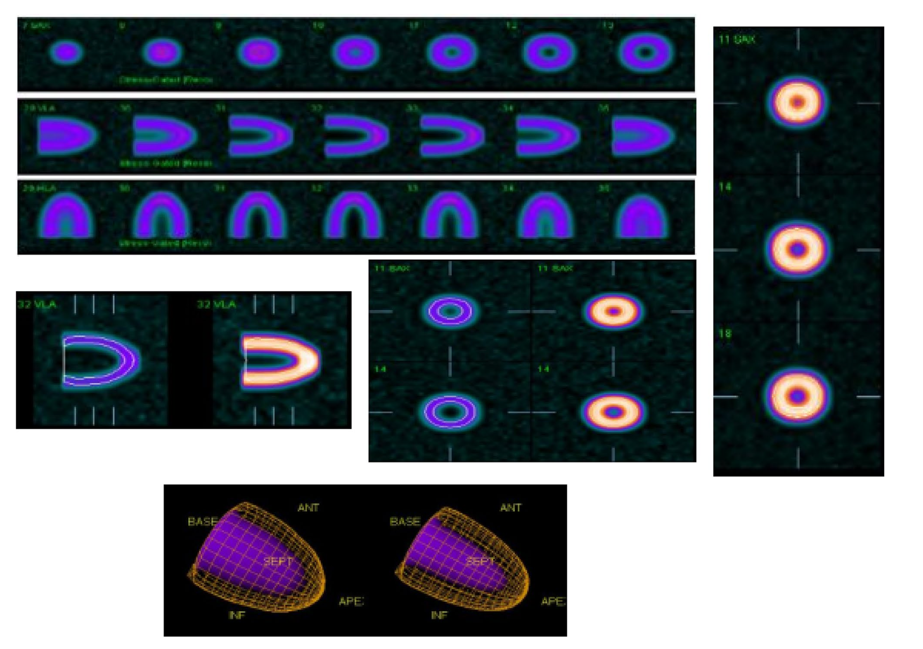
Accurate myocardial slices consistent with SPECT images
Notes:
They successfully produced myocardial slices consistent with routine spect images.
This particular image displays their success in producing myocardial slices with gating features at the end of the diastole and systole phases. Providing clear demonstration of the phantoms capabilities to produce a realistic myocardial image.

Slide 12
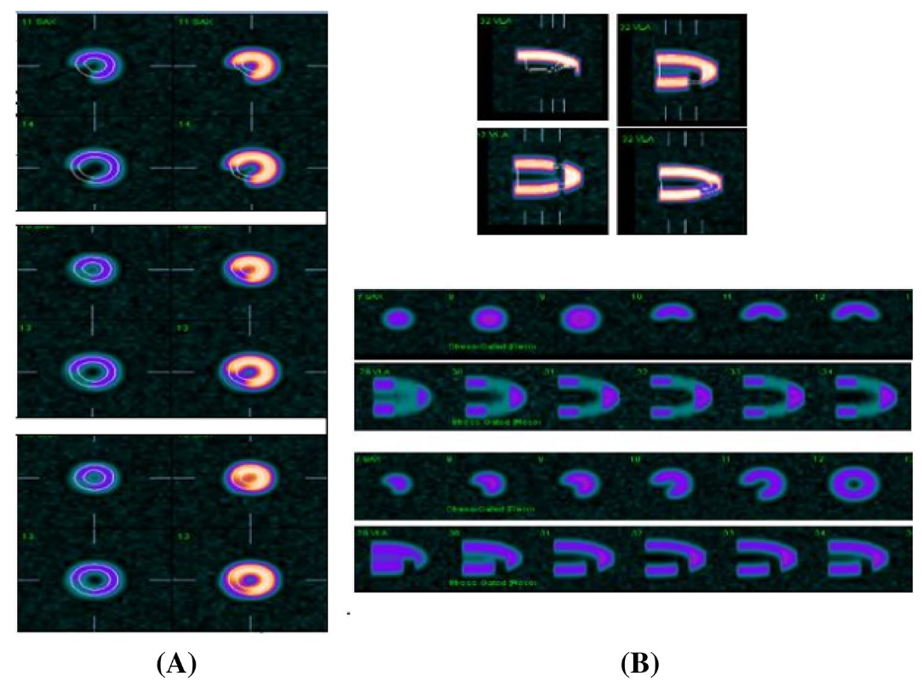
Various defect severities simulated
Notes:
Additionally, they were able to show images at defects of 70, 90 and 100%. This particular image is Figure 4 in the article and it illustrates the effect of defect severity increases and the defect count decreases proportionally.

Slide 13
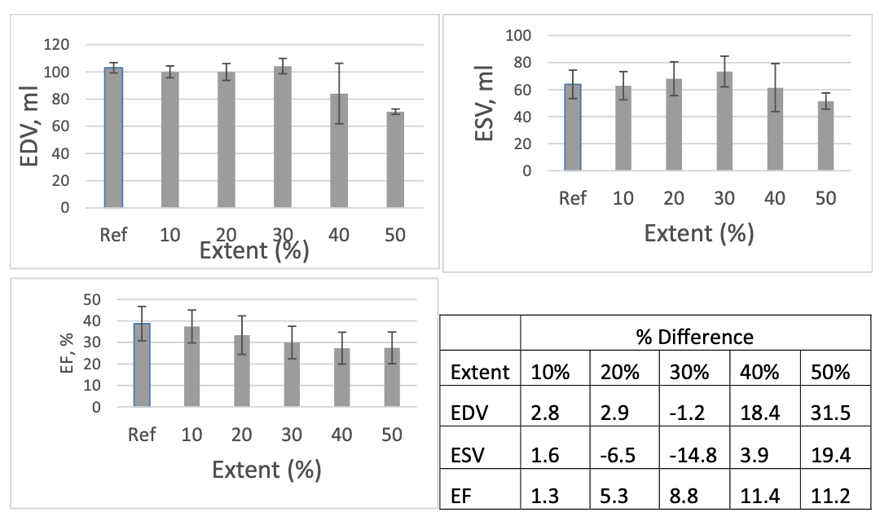
Accurate EDV, ESV, EF parameters
Notes:
This is figure 6 from the article. And here it shows the mean EDV ESV and EF for different defect extents and severities comparing the software measurements using the computational phantom with clinical data further validating the accuracy of the functional parameters and using their computational phantom.

Slide 14
My Thoughts
Notes:
The paper presents a significant contribution to the field of medical imaging by leveraging pythons capabilities. The developed phantom provides a flexible platform to simulate various myocardial conditions with great accuracy. It makes it a very useful tool for validating and improving quantitative analysis software used in SPECT imaging.

Slide 15
References
NumPy developers. (n.d.). NumPy logo. Retrieved from https://github/com/numpy/numpy/tree/main/branding/logo
SciPy devleopers (n.d.). Scipy logo. Retrieved from https://github.com/scipy/scipy.org/blob/main/static/images/logo.svg
Biopython. (n.d.). Biopython logo. Retrieved from https://biopython.org/wiki/logo
Hanafy, O. S., Khalil, M. M., Khater, I. M., & Mohammed, H. S. (2020). Development of a new Python‐based cardiac phantom for myocardial SPECT imaging. Annals of Nuclear Medicine, 23(1), 257. https://doi.org/10.1007/s12149-020-01534-y
Matplotlib developers. (n.d.). Matplotlib logo. Retrieved from https://matplotlib.org/stable/gallery/misc/logos2.html
pandas development team. (n.d.). Pandas logo. Retrieved from https://pandas.pydata.org/about/citing.html
Python Software Foundation. (n.d.). Python logo. Retrieved from https://www.python.org/community/logos/
Splettstoesser, T. (n.d.). Cas9 protein structure [Image]. Wikimedia Commons. Retrieved from https://en.wikipedia.org/wiki/Cas9#/media/File:Cas9_5AXW.png

Slide 16
Questions?

